Slide 1

AIRBNB HOTEL BOOKING ANALYSIS
Author: Arshiya Khan
Internship ID: INTERNSHIP_17546440516895be537820f

Slide 2

PROBLEM STATEMENT
Airbnb is a widely used platform that enables property owners to rent out their homes or apartments to travelers. However, one of the major challenges faced by hosts is determining the optimal pricing for their listings. The price of a listing depends on various factors such as the number of bedrooms and bathrooms, level of cleanliness, accuracy of the property description, and the quality of communication with guests. Establishing the right price is crucial for attracting potential guests while ensuring maximum profitability for hosts.

Slide 3
Project Description This project aims to develop a machine learning model capable of accurately predicting the prices of Airbnb listings. Setting the right price for an Airbnb property is essential for both hosts and travelers — hosts seek to maximize occupancy and revenue, while travelers look for fair and competitive rates. By leveraging historical Airbnb data, the project builds a regression-based model that identifies and learns the relationships between various listing attributes — such as the number of bedrooms, bathrooms, cleanliness ratings, and guest reviews — and the corresponding prices. The resulting model can be utilized to estimate prices for new or hypothetical listings, thereby assisting property owners in making data-driven and informed pricing decisions that enhance both profitability and guest satisfaction.

Slide 4

WHO ARE THE END USERS?
Airbnb Hosts : To optimize the pricing of their listings based on property features, location, and guest reviews.
Travelers : To assess whether a listing is fairly priced or overpriced before making a booking decision.
Airbnb Platform Analysts : To enhance automated pricing algorithms and strengthen trust in platform recommendations.
Researchers and Students : To analyze the relationship between property characteristics, guest feedback, and rental pricing trends.

Slide 5

Technology Used
Python – Core programming language for implementation.
Pandas & NumPy – Data cleaning, preprocessing, and manipulation.
Scikit-learn – Machine learning (model training, regression, and evaluation).
Matplotlib & Seaborn – Data visualization and feature analysis.
Google Colab – Cloud-based environment for project execution.
File Handling Libraries – openpyxl (Excel integration) and built-in CSV handling.

Slide 6
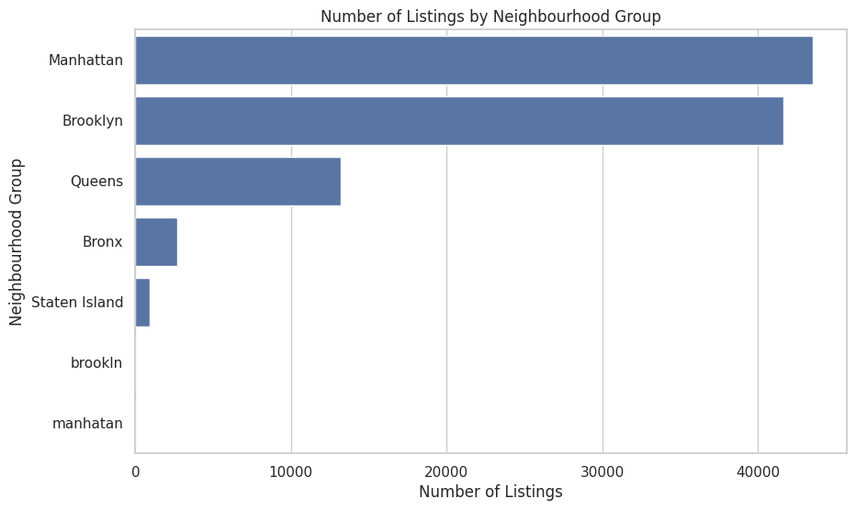
RESULTS1

Slide 7
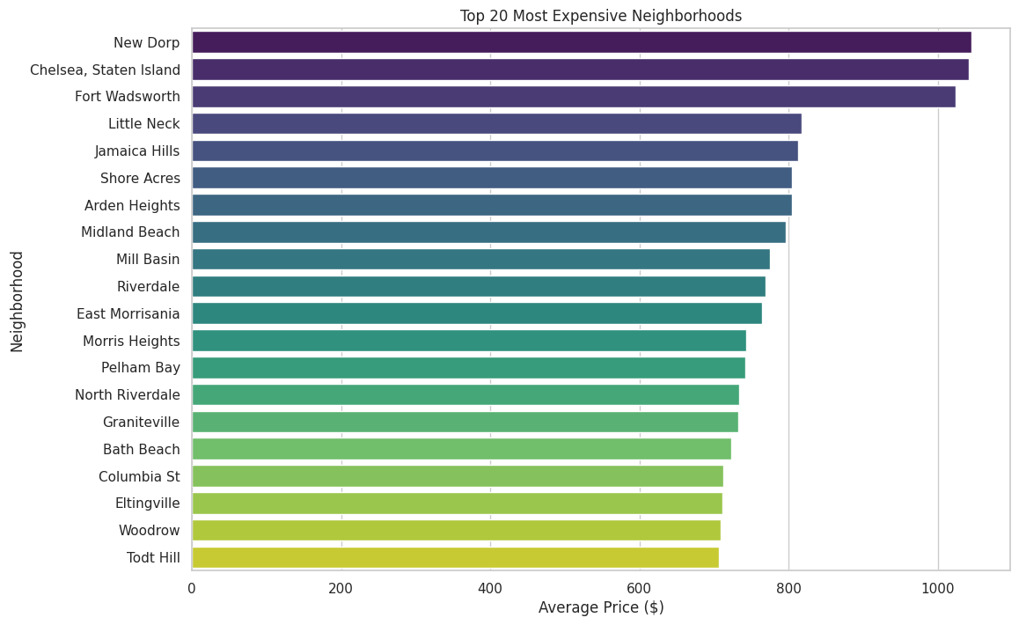
RESULTS2

Slide 8
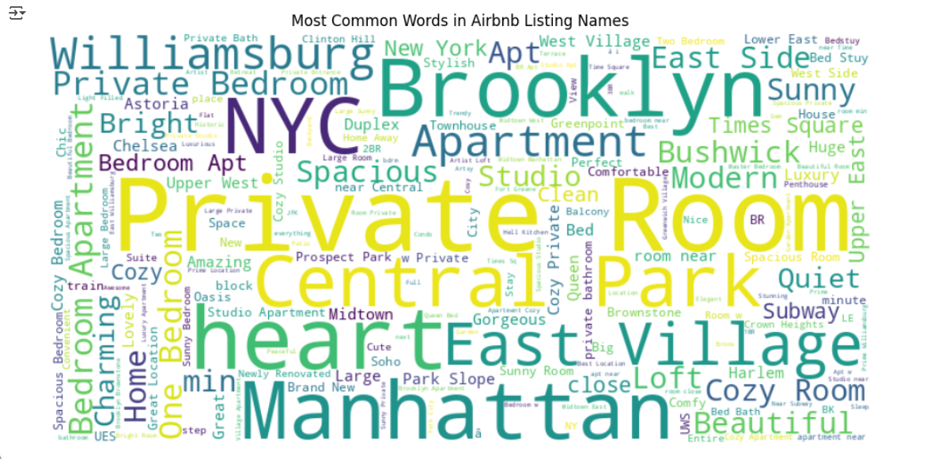
RESULTS3

Slide 9
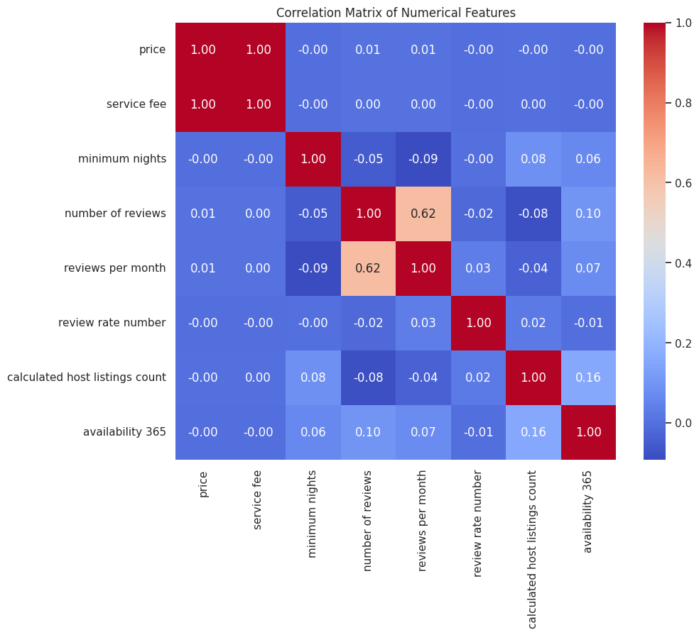
RESULTS4

Slide 10
GitHub repository
https://github.com/arshiyakhan1613/VOIS_AICTE_Oct2025_ARSHIYA_KHAN

Slide 11
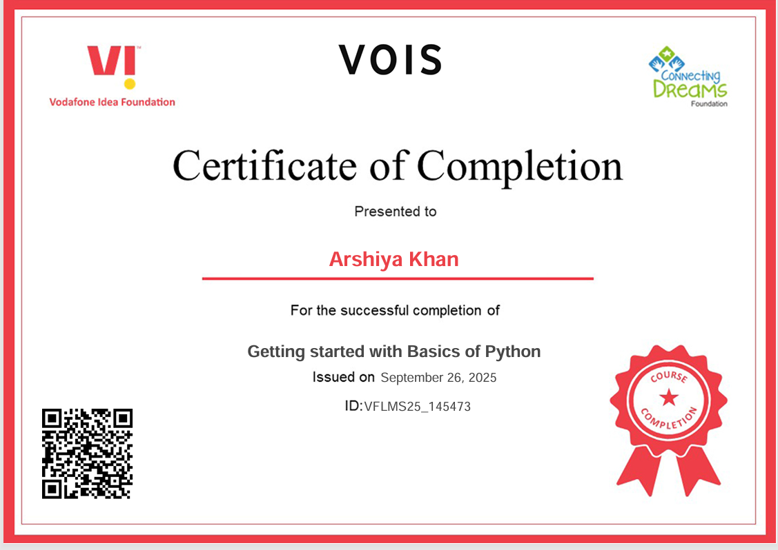
Getting started with Basics of Python Certificate

Slide 12
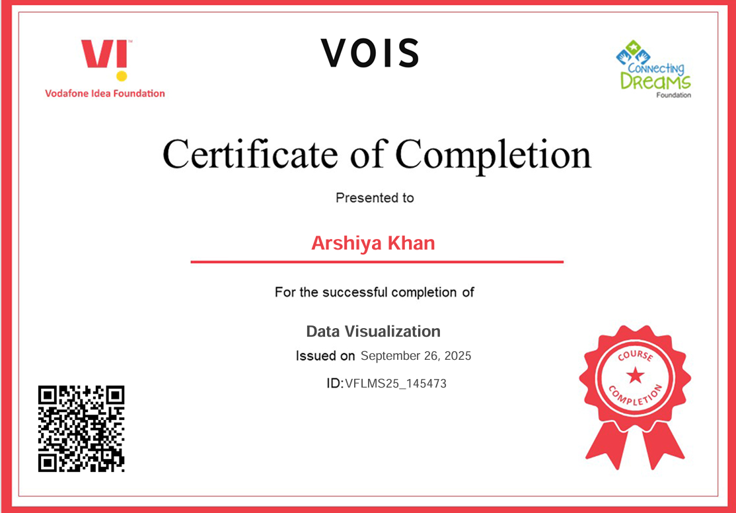
Data Visualization Certificate

Slide 13
Thank you
.
.

